Slide 1
SEO Basics
Today, we'll delve into key SEO basics to boost your website's visibility and drive organic traffic.
By Vaishnavi Ankam

Slide 2
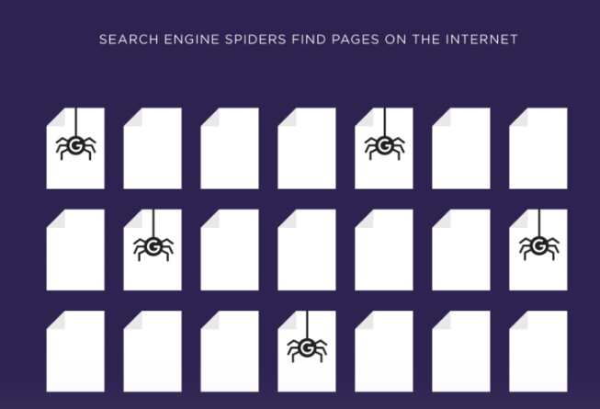
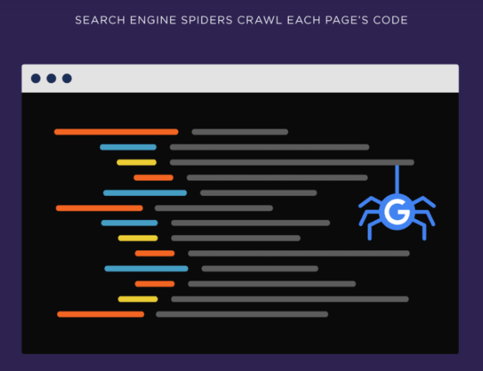
How Search Engines Work
Search engines send out search engine spiders to find pages on the internet.
A Web crawler, sometimes called a spider or spider bot and often shortened to crawler, is an Internet bot that systematically browses the World Wide Web and that is typically operated by search engines for the purpose of Web indexing (web spidering)
Next, they crawl each page’s code.

Slide 3
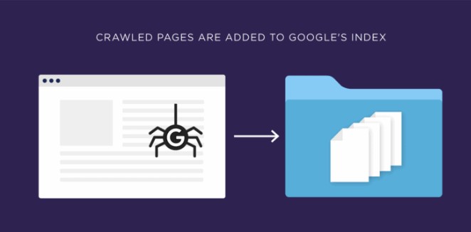
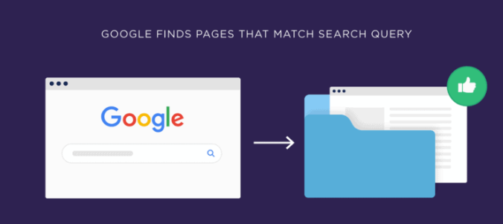
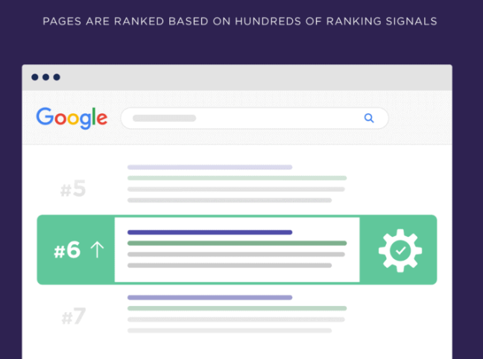
Once the page is crawled, the page is added to the search engine’s index, which is a cached collection of pages.
In other words: when you do a Google search, you’re not getting back live results. Instead, Google is showing you pages from its index. That’s why you get Google results within milliseconds.
When someone searches, Google looks for pages in its index that match the person’s query.
And they rank those pages based on hundreds of factors in their algorithm.

Slide 4
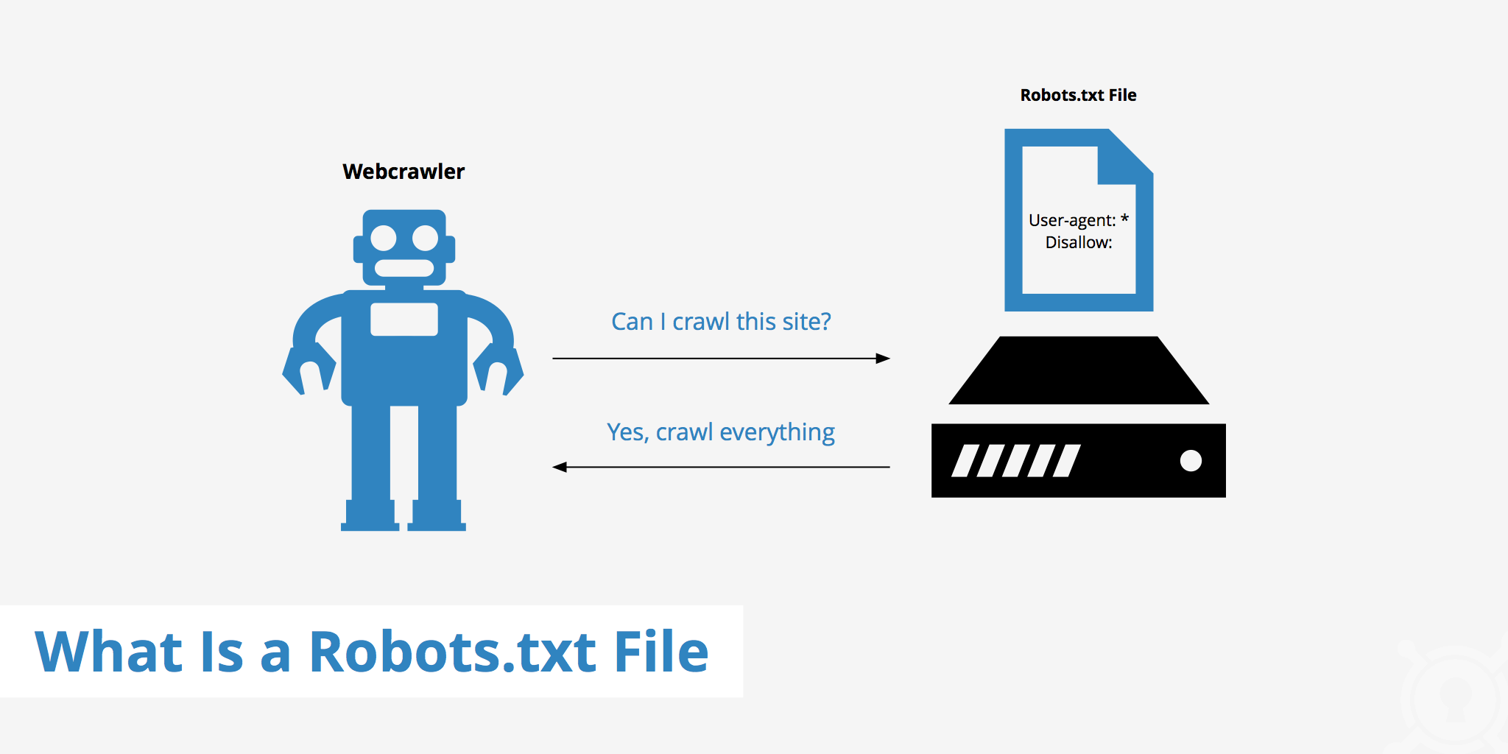
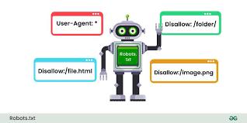
RoBots.Txt
A robots.txt file tells search engine crawlers which URLs the crawler can access on your site. This is used mainly to avoid overloading your site with requests.

Slide 5
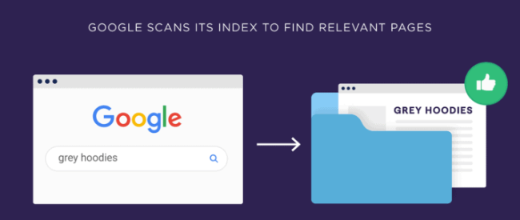
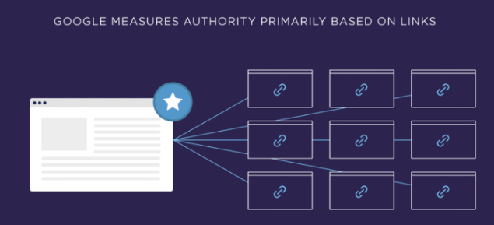
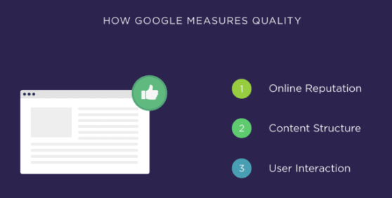
Important Search Engine Ranking Factors
Google uses 200+ ranking factors in their algorithm. Most of the 200 ranking factors are different ways of measuring 3 things: relevancy, authority and quality.
Relevancy is how well a page matches someone’s search.
Authority is how much Google trusts the content on a page.And they measure authority primarily based on links.The more links a page has pointing to it, the more authority that page has in Google’s eyes.
Quality is based on a few different factors, like your site’s online reputation, your content’s structure, and how users interact with your site in the search results.

Slide 6
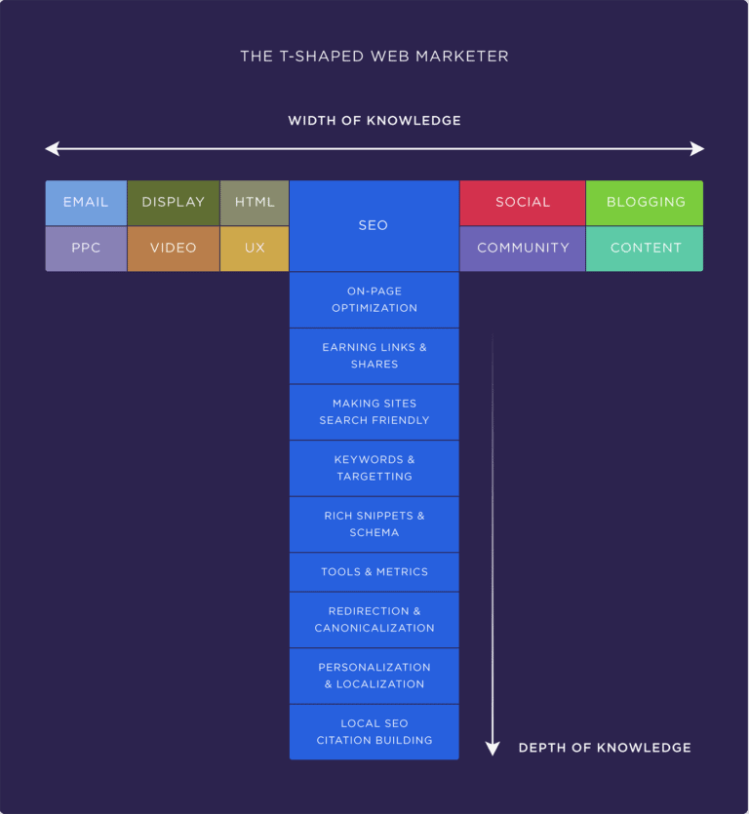

Slide 7
DO: KNOW TARGET AUDIENCE
Your strategies should align with a specific user persona.
Think of who is searching for what you're offering.
Research the market and create relevant content.

Slide 8
Scenario: You own a hair transplant clinic in Pune and want to attract potential patients through digital marketing.
Step 1: Define the User Persona
Name: Priya Sharma
Age: 32
Location: Pune
Profession: IT Professional
Pain Point: Experiencing hair loss, leading to decreased confidence.
Goal: Wants a reliable, affordable, and permanent solution for hair restoration.
Behavior: Frequently searches for information online before making a decision. Active on Google and Instagram.
Step 2: Align Strategies with the Persona
1. Research the Market
Analyze what people like Priya are searching for, such as:
"Best hair transplant in Pune"
"Hair transplant cost in Pune"
"Is hair transplant permanent?"
2. Create Relevant Content
Informative Blog Articles:
"The Complete Guide to Hair Transplants in Pune"
"What to Expect After a Hair Transplant Procedure"
FAQs on Your Website:
"How much does a hair transplant cost in Pune?"
"What are the side effects of hair transplantation?"
Social Media Content:
Share patient success stories with before-and-after images on Instagram.
Post informational reels addressing common concerns like pain, cost, and recovery.
Videos:
Create short videos on YouTube explaining the procedure step-by-step.

Slide 9
3. Optimize for Search Engines
Use the keywords Priya is likely searching for, such as "affordable hair transplant clinic in Pune" or "best results for hair loss treatment."
Ensure your website is mobile-friendly, as Priya might browse on his phone.
4. Tailored Ads:
Run Google Ads targeting keywords like "safe hair transplant clinic near me."
Use Instagram ads showing testimonials, targeting professionals aged 25-40 in Pune.
Step 3: Measure & Adapt
Track the success of your strategies using tools like Google Analytics or Facebook Insights. Adjust your content and ads based on the engagement and inquiries from potential users like Priya.
By tailoring your marketing efforts to align with your user persona, you address their specific needs, build trust, and are more likely to convert them into customers

Slide 10
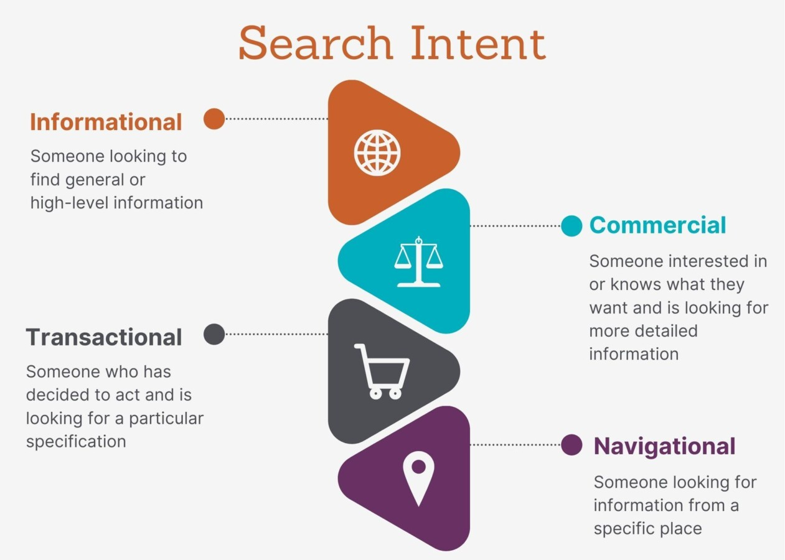
Search Intent of Users
Informational Intent: Users are seeking information or answers to questions. They are not ready to make a purchase, just gathering knowledge.
Commercial Intent: Users are comparing options and gathering information before making a purchase. They are in the consideration phase, not yet ready to buy.
Navigational Intent: Users want to find a specific website or page. They use search engines as a shortcut to their destination.
Transactional Intent: Users are ready to make a purchase or take action. They are looking to buy a product or service immediately.

Slide 11

DO: TEST ON ALL DEVICES
Multiple devices are used to consume content, make online purchases, access websites, and get information.
Optimizing your site for different devices is essential.
To ensure a seamless experience for your audience, it’s crucial to optimize your website for different screen sizes, resolutions, and device types.

Slide 12
DO: HAVE AN FAQ PAGE
Your goal is to serve your audience. When they have questions, it's ideal to have answers ready. A FAQ page saves time for everybody and makes your site more efficient.

Slide 13
DON’T IGNORING IMAGES
‘Cuz content without images is not user friendly
Images are useful because they:
Increase time on page
Improve user experience
Make content skimmable
Help with information retention

Slide 14
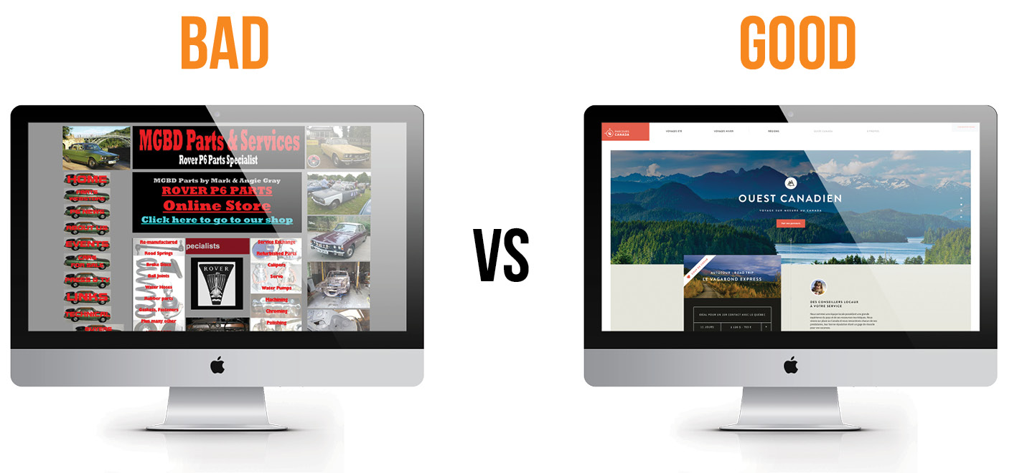
Bad content design
includes:
Font too small
Wide text layout
Images too small
Not enough line height
Poorly designed bullet lists
No space around headings

Slide 15
Slow Website Loading Speed
User experience depends on many factors.
Chances of losing visitors before they open your page can increase if you don't take care of slow loading times.

Slide 16
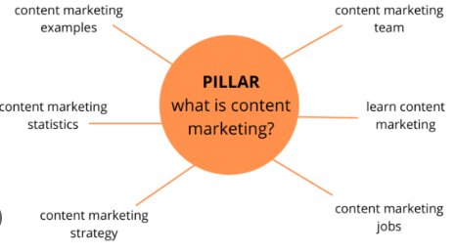
COVERING RANDOM TOPICS
Covering a bit of everything is a mistake.
Because you won't be able to build enough topical authority. That means you won't rank in the top 10 search results.
Pick one topic and stick to it.
Use Pillar and Cluster Model:
The Pillar and Cluster Model organizes content into a central pillar page (broad topic) supported by clusters of related subtopics interlinked for SEO. This structure improves content organization, boosts search engine rankings, and enhances user navigation.

Slide 17
IGNORING TOPICAL AUTHORITY
Topical authority is a SEO highway.
If you build it, it speeds up your results drastically!

Slide 18
Topical Authority
Topical authority is an SEO concept that measures how well a website establishes itself as an expert on a specific topic:
Definition
Topical authority is a website's credibility and expertise in a niche or subject. It's a system that Google uses to determine which experts are most helpful to a searcher's query.
Benefits
Websites with high topical authority are more likely to rank better for topically related keywords. They're also seen as reliable sources of information by users and search engines.

Slide 19
PUBLISHING INCONSISTENTLY
SEO thrives on consistency.
That’ s because: You keep pinging Google.
It influences freshness SEO signals.
It helps maintain rankings over time
So avoid having big gaps in your publishing schedule.

Slide 20
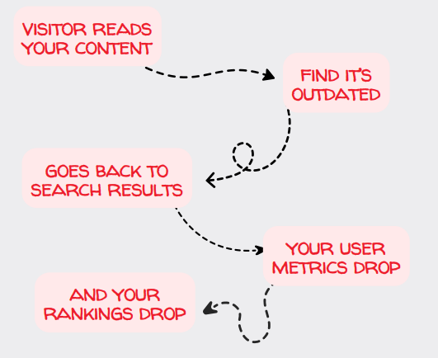
NOT UPDATING YOUR CONTENT
Here ’s how the story goes:

Slide 21
avoid having this in your content:
Old research data
Outdated practices
Wrong trend predictions
Mentions of closed companies
Old names from acquired brands

Slide 22
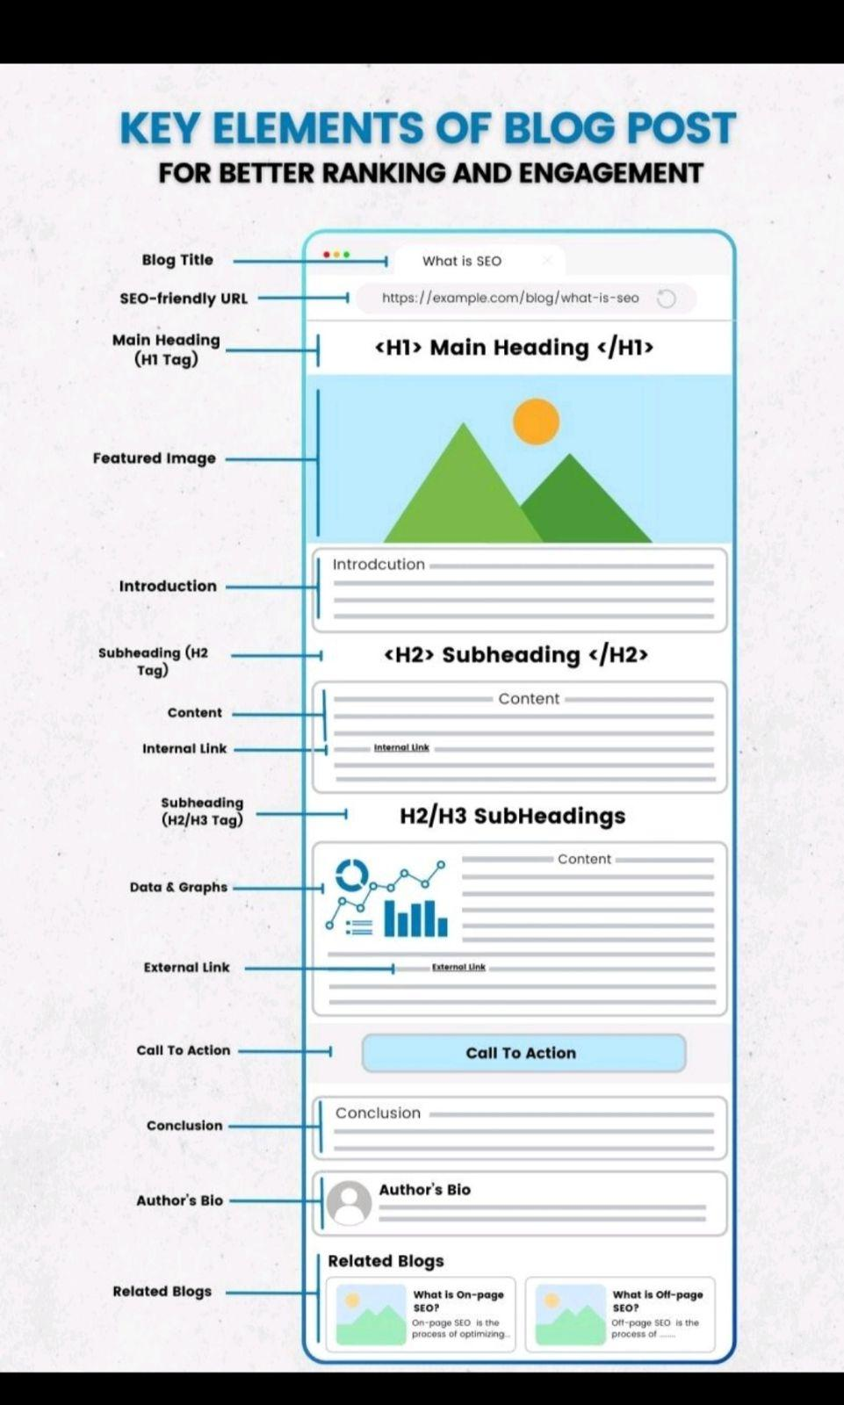
Key Elements of Blog Post
Blog Title
SEO Friendly URL:
Main heading (H1 Tag)
Featured Image
Table of Content
H2 – Subheading
Content and Internal Linking
H2/H3 – Subheadings
Data and Graphics
External Links
Call To action
Conclusion
Author’s Bio
Related Blogs

Slide 23
THANK YOU

